Slide 1
Module- 1/2
Module : 1 /2
class: VII
Subject: English( Honeycomb)
Name of the chapter: Chapter -3 Gopal and the Hilsa Fish
Name of the Teacher: Mrs. Eva Guria
Name Of the School: AECS, Narwapahar

Slide 2
Introductory question Can you name the fish you see in the pictures?

Slide 3
What is Hilsa Fish?
Hilsa fish is a very popular food fish in South Asia. Hilsa is considered as one of the most tastiest fishes due to its distinctly soft oily texture and mouthwatering flavour. . It is a very important species of fish in Bangladesh. In West Bengal and Bangladesh Hilsa is often termed as the “Queen of fishes” .It is mostly sold during monsoon season i.e. from June – September.

Slide 4
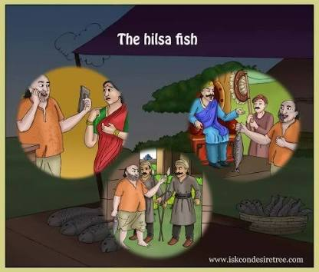
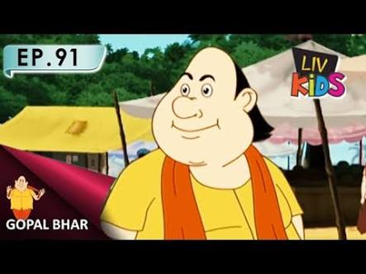
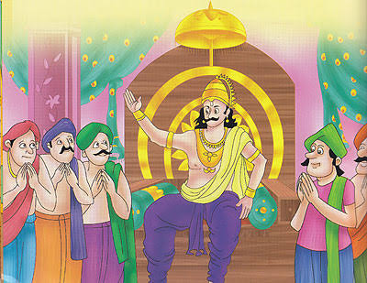
CHAPTER-3 GOPAL AND THE HILSA FISH
CHARACTERS OF THE STORY :
Gopal, The King, King’s Courtiers, Gopal’s wife

Slide 5
GOPAL: THE MAIN CHARACTER OF THE STORY
Gopal was a brilliant courtier in the king’s court. He was just like Birbal and Tenalirama. He was very witty and had a solution of all the problems. He was very loyal to the king . By his intelligence, he managed to bring the Hilsa fish in the palace without any anyone noticing about it and accomplished his goal.

Slide 6
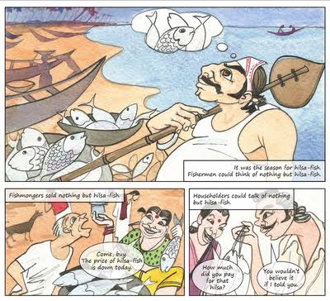
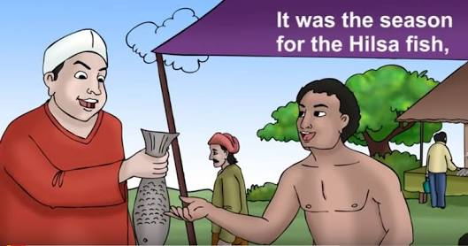
Hilsa Fish Season It was the season of Hilsa fish and everybody was talking about Hilsa Fish. Fishermen, fishmongers and householders were interested only in Hilsa Fish.

Slide 7
Even the King’s court was not an exception . In the royal court,thecourtiers were also talking about the Hilsa fish.One of the courtiers asked the king if he had seen the Hilsa fish he had cought.Hilsa had become above the state affairs.

Slide 8
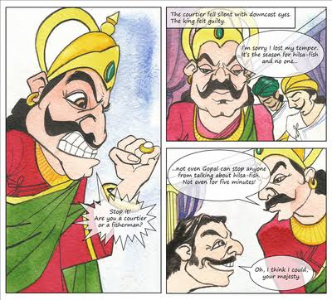
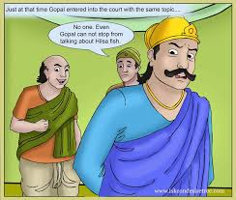
The king gets angry
Hearing the courtiers’ talk, the king lost his temper. But soon the king realised that no could stop people from talking about Hilsa fish not even Gopal who was the wisest man in his court.

Slide 9
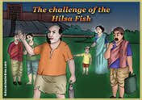
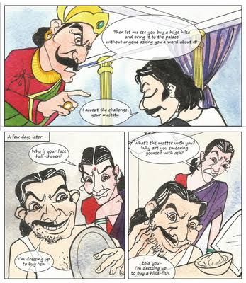
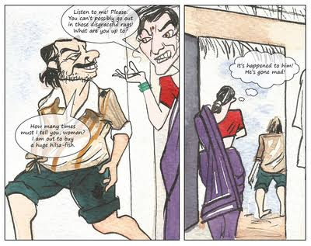
The king challenges Gopal
The king challenged Gopal to buy a Hilsa fish and bring it to the palace without anyone noticing about it. Gopal accepted the challenge and made some preparation for it. He did three things to change his look. He half- shaved his face, smeared himself with ash and worn tattered cloth. This made his wife surprised and asked him not to go out in such disgraceful attire.

Slide 10
To be continued………

